Slide 1
Fake Job Posting Prediction
Final Project
FSRM 588 Data Mining
Spring 2020
Team Members: Sanket Badhe, Isha Raju, and Akshay Sitlani

Slide 2
Objective and Applications
Objective:
Classification of the given set of job postings into “Real” or “Fake”
Applications:
Identification and removal of fake job postings from job portals.
This will help prevent cyber crime, spam email distribution, unfair hiring practices i.e. employment scams, loss of private information of job applicants, plagiarism (esp. resume), and company’s financial and reputation loss.

Slide 3
About the Data
Employment Scam Aegean Dataset
University of the Aegean
Laboratory of Information & Communication Systems Security

Slide 4
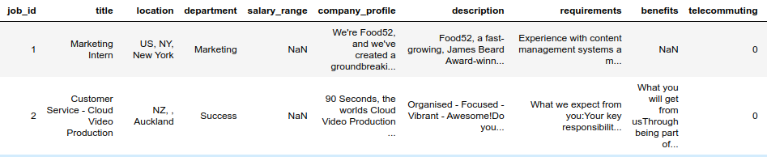
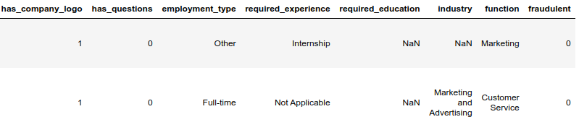
About the Data

Slide 5
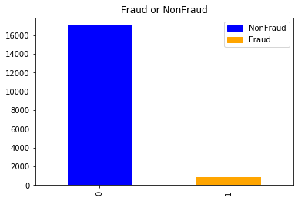
Highly Imbalance data
Dataset contains 18k job postings out of which only 800 are fake job postings.

Slide 6
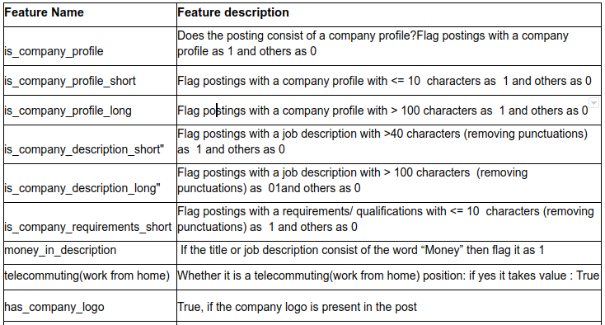
Feature Engineering

Slide 7
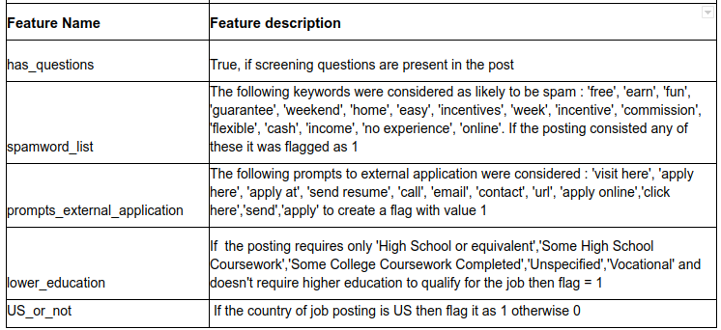
Feature Engineering Continue

Slide 8
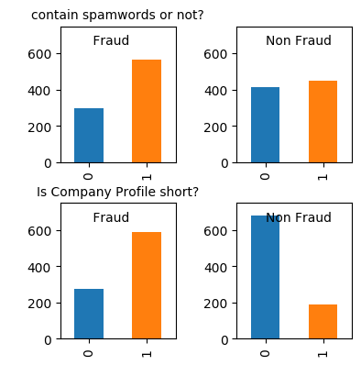
Results of Feature Engineering

Slide 9
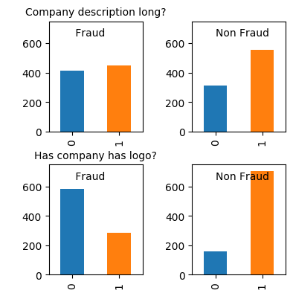
Results of Feature Engineering

Slide 10
Exploratory Data Analysis
Bag of Words Modelling: In this technique each individual word token occurrence frequency is treated as a feature. vector of all the token frequencies for a given posting is considered a multivariate sample.
CountVectorizer: CountVectorizer works on Terms Frequency, i.e. counting the occurrences of tokens and building a sparse matrix of documents x tokens.
TF-IDF: term frequency–inverse document frequency, is a numerical statistic that is intended to reflect how important a word is to a document in a collection or corpus.

Slide 11
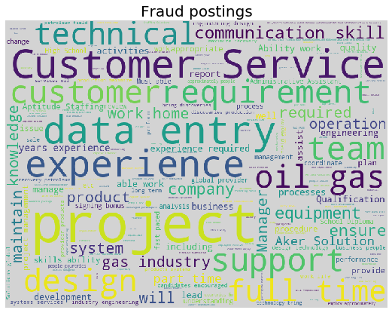
Word Cloud for Fraud Posting

Slide 12
Feature Importance using Random Forest
In decision trees, quality of split at any given node is quantified by gini impurity (must be low) and information gain (entropy) (entropy must be low, and information gain must be high).
In Scikit-Learn, this is achieved using the feature_importances_ attribute.

Slide 13
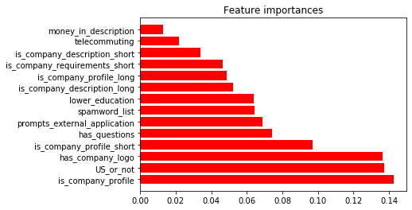
Feature Importance using Random Forest

Slide 14
Feature Selection based on Recursive Feature Elimination (RFE)
Given an external estimator that assigns weights to features (e.g., the coefficients of a linear model), the goal of recursive feature elimination (RFE) is to select features by recursively considering smaller and smaller sets of features.
First, the estimator is trained on the initial set of features and the importance of each feature is obtained either through a coef_ attribute or through a feature_importances_ attribute.
Then, the least important features are pruned from current set of features. That procedure is recursively repeated on the pruned set until the desired number of features to select is eventually reached.

Slide 15
Feature Selection based on Recursive Feature Elimination (RFE)
1. feature is_company_profile_short
2. feature telecommuting
3. feature prompts_external_application
4. feature US_or_not
5. feature has_questions
6. feature lower_education
7. feature is_company_description_short
8. feature is_company_description_long
9. feature has_company_logo
…...
Features in a ranked order

Slide 16
Up and Down Sampling
Down Sampling | Up Sampling
Strategy to handle imbalanced classes by creating a random subset of the majority class which has equal size as that of the minority class. | Strategy to handle imbalanced classes by repeatedly sample with replacement from the minority class to make it of equal size of the majority class.
Drawbacks: May discard potentially useful data | Drawbacks: leads to overfitting, increases number of training examples, and hence the learning time.
Two types of up sampling techniques: RandomOverSampler and SMOTE

Slide 17
RandomOverSampler and SMOTE
RandomOverSampler: This doesn’t add new information to the model. It is basically sampling with replacement.
SMOTE (Synthesised Minority Oversampling Technique): It’s an oversampling technique where in we synthesise new examples from the existing examples from the minority class.

Slide 18
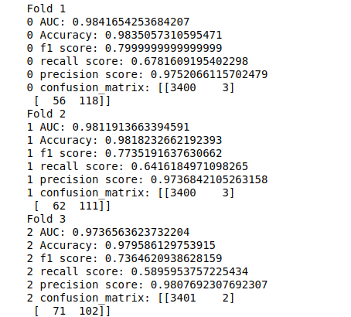
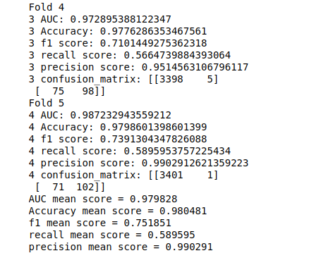
Model selection : k-fold cross validation

Slide 19
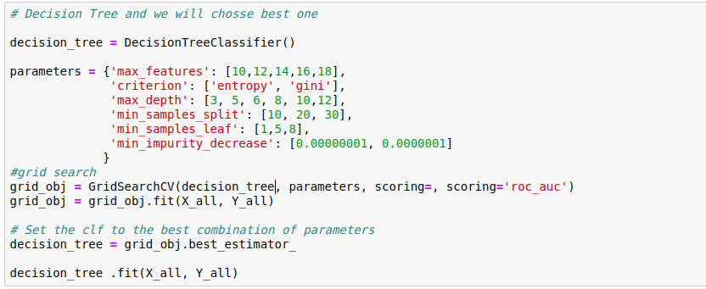
hyperparamter selection : GridsearchCV
Exhaustive search over specified parameter values for an estimator.
Important members are fit, predict.
GridSearchCV implements a “fit” and a “score” method. It also implements “predict”, “predict_proba”, “decision_function”, “transform” and “inverse_transform” if they are implemented in the estimator used.
The parameters of the estimator used to apply these methods are optimized by cross-validated grid-search over a parameter grid.

Slide 20
Trained without sampling and tested on imbalance
Technique | AUC score | F1 Score | Precision Score | Recall Score | Accuracy score
Multinomial Naive Bayes | 0.94 | 0.61 | 0.97 | 0.46 | 0.97
Logistic Regression | 0.97 | 0.75 | 0.99 | 0.58 | 0.98
Decision Tree | 0.87 | 0.80 | 0.85 | 0.73 | 0.98
Random Forest | 0.98 | 0.81 | 0.99 | 0.69 | 0.98
Gradient Boosting | 0.97 | 0.80 | 0.95 | 0.70 | 0.98

Slide 21
Trained with sampling(downsampling) and tested on imbalance
Technique | AUC score | F1 Score | Precision Score | Recall Score | Accuracy score
Multinomial Naive Bayes | 0.96 | 0.46 | 0.31 | 0.87 | 0.90
Logistic Regression | 0.96 | 0.44 | 0.29 | 0.90 | 0.89
Decision Tree | 0.83 | 0.30 | 0.18 | 0.85 | 0.80
Random Forest | 0.97 | 0.5 | 0.35 | 0.89 | 0.91
Gradient Boosting | 0.96 | 0.41 | 0.27 | 0.91 | 0.87

Slide 22
Summary and Areas of improvement
We found Random forest to perform the best among all the models that we worked on.
Our Problem had two major challenges :
Imbalanced data - We performed downsampling for it, however the results were better for imbalanced data. Other Upsampling methods like SMOTE can be explored. Currently SMOTE for free text data did not have enough information.
Free text in features - We used countvectorizer and TFIDF in python for the results that we obtained. We would like to explore Glove - word2vec for representing text in vectors and see if it can improve the model.

Slide 23
Thank you!

